Slide 1
Orleans Transportation and
Bikeways Advisory Committee
Project Review February 5 2025
Members: Alice Thomason, Scott Macdonald, Peter Allgeier, Geof Deering, Stephanie Gaskill, Lindsey Goodman, George Meservey, Doug Prentiss, Griffin Ryder, Calvin Sutton, Richard Waldo

Slide 2
The committee has been doing preliminary work on three key projects which we believe will enhance the safety and enjoyment of significant town roadways and in doing so will advance safety, health and environmental goals of the town. * Two of these projects were at the top of the Complete Streets Prioritization Plan list and the third was and has been under consideration before the creation of the Plan.
Project Status
Old Colony Road 2 Design Options under consideration
Main Street * Concept Plans under discussion
Beach Road * Feasibility Study Underway
These projects have also been targeted in various town planning documents

Slide 3
Old Colony Way
Improvements for Old Colony Way have been under discussion for years. Some action has been taken but more needs be done.
Problem Solutions to Date
Issues Remedies to date
Speeding Vehicles | “Road diet” by way of a few bump outs
Poor visibility for cars entering and exiting parking lots due to streetside parking | Some striping has deterred drivers from parking in blind spots.
Sidewalk improvements needed: Width of walk limiting and material needs upgrade. | Added 800’of sidewalk on each side from Main; improved crosswalks.
No safe accommodations for bicyclists choosing to access the retail areas and village. | Shared path or bike lane needed

Slide 4
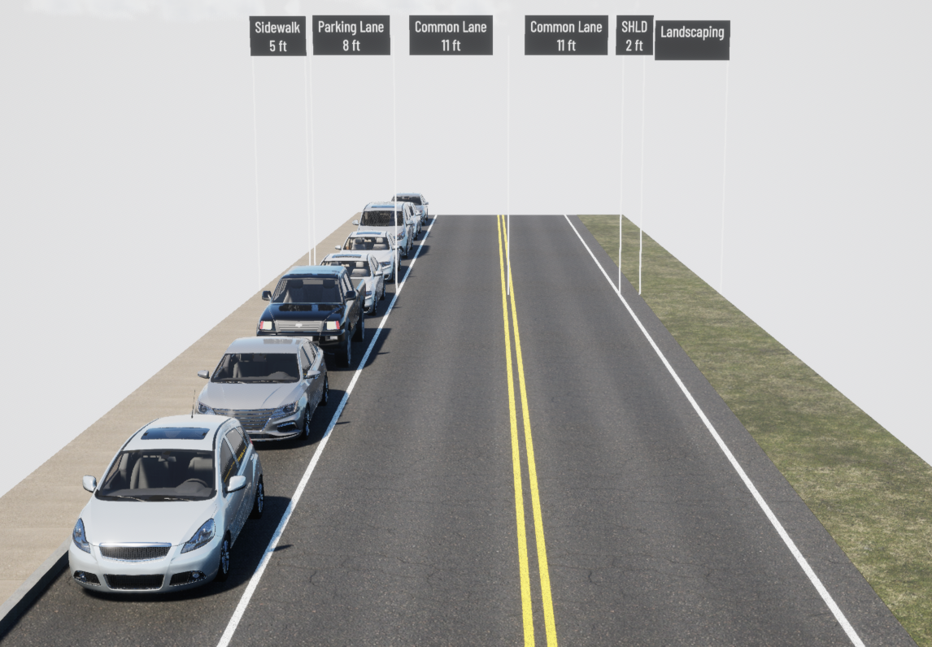
Old Colony Design Option 1
Continuous side walk on the north side with on road parking
Segmented sidewalk on south with parking
Bump outs for crosswalks and driveway sight distance

Slide 5
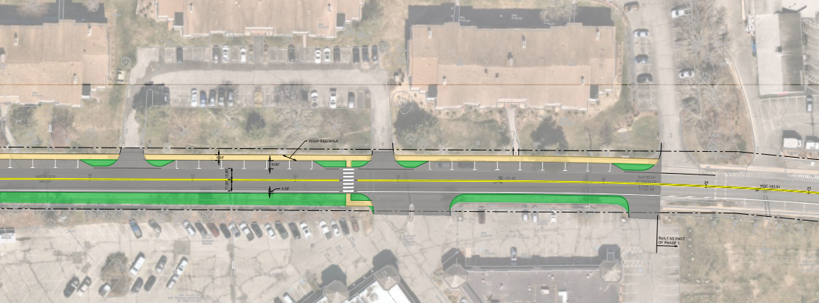
Old Colony Design Option 1
N
Limit of Work – Meet Phase 1

Slide 6
Old Colony Option 1
Pros and Considerations
Possible cost savings.
No loss of parking on south side
Reduced overall pavement width encourages reduced speed
>>>>>>>>>>>>>>>>>>>>>>>>>>>>>>>>>>>>>>>>>>>>>
Old Colony residents concerned about bicyclists on sidewalk
Bicycles on street subject to vehicle movements (doors opening and vehicles turning)
Continues existing pedestrian /biker conflicts
Hard curbing less appealing – not liked by residents
Narrow sidewalks support only limited walking situations
Anticipated increase in pedestrian and bike traffic from Penrose & Gov Prence will further congest area.

Slide 7
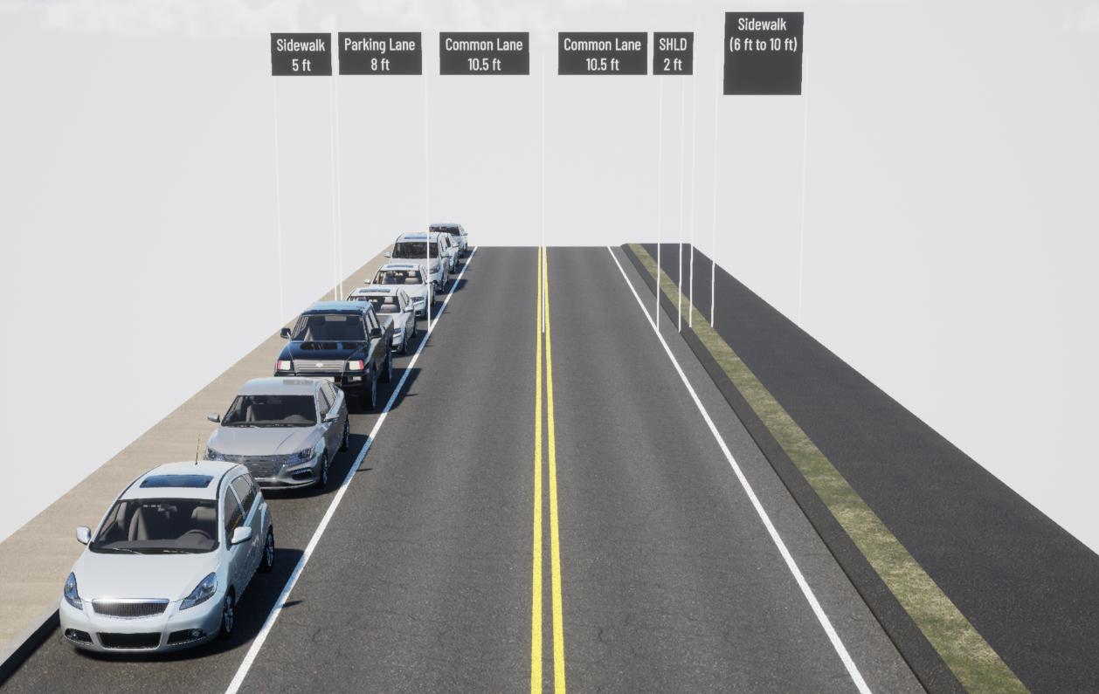
Old Colony Design Option 2
Separated bike and walk accommodations by way of a wide sidewalk on the south; no on street parking
Continuous sidewalk on the north with on street parking
Bump outs for crosswalks and driveway sight distance

Slide 8
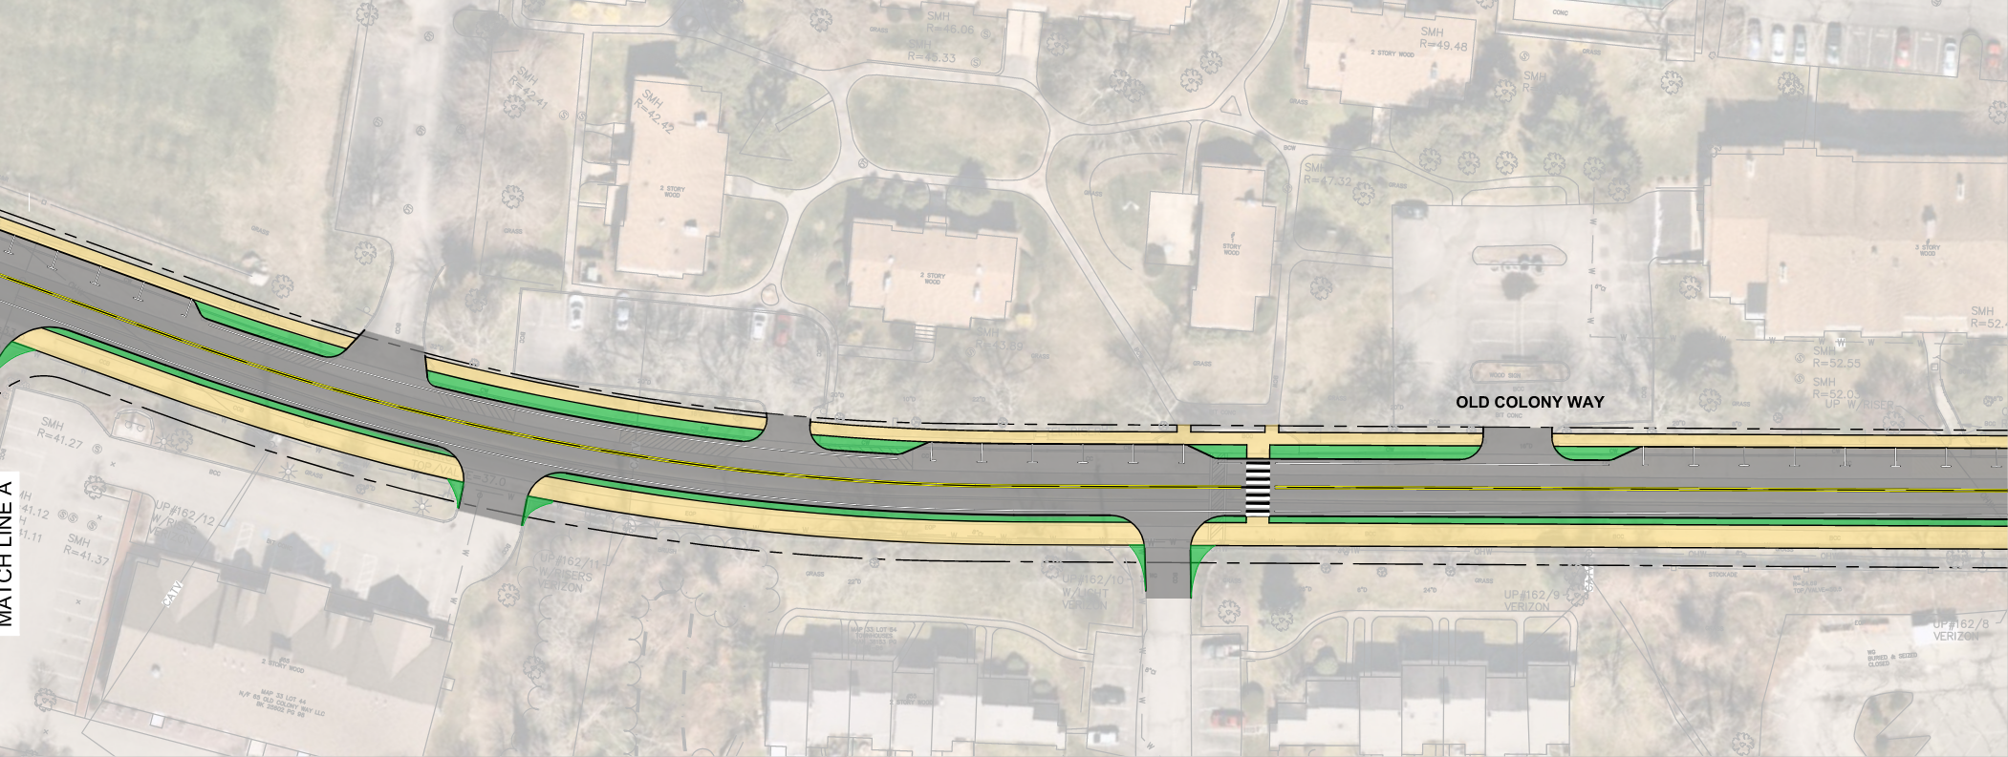
Old Colony Design Option 2
N
Spaulding
Bayberry Village

Slide 9
Old Colony Option 2
Pros and Considerations-Unanimous Committee Support
Improved safety for pedestrians, bicycles and vehicles
Less bicycle/pedestrian crowding and conflicts
Bicycle safety w/ off-street path non reliant on CCRT (no lighting & used for recreation)
Accommodations for increased walking situations (strollers; partners; wheelchairs etc.)
Easier road predictability for vehicles with bikes minimized
Better accessibility and connectivity for Penrose, Gov. Prence and other community pods to downtown area.
Accommodates all non-vehicle users
Provides a reduction in pavement width for speed control.
>>>>>>>>>>>>>>>>>>>>>>>>>>>>>>>>>>>>>>>>
Perceived redundant to Rail Trail
Reduces parking on south side of road

Slide 10
Main Street (Rt 28 to Beach Rd)
Concepts Under Discussion
Option 1
Improve the sidewalk on the North side only and create separated bike lanes next to the travel lanes. Potential 51/2’ sidewalk north and 5 ’ adjacent bike lanes north and south)
Option 2
Improve the sidewalk on the North Side and have a shared use path (or wide sidewalk) on the South side.

Slide 11
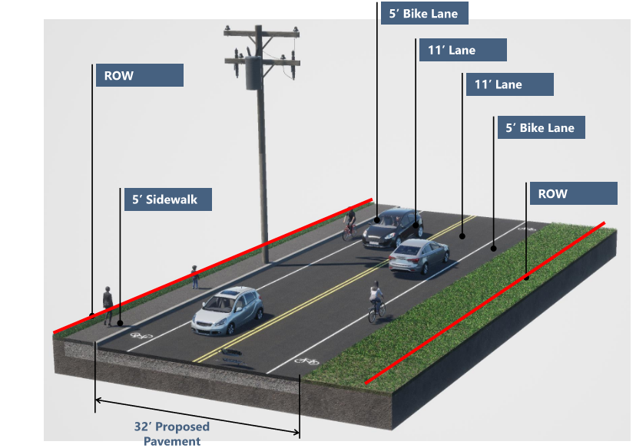
Main Street Option 1

Slide 12
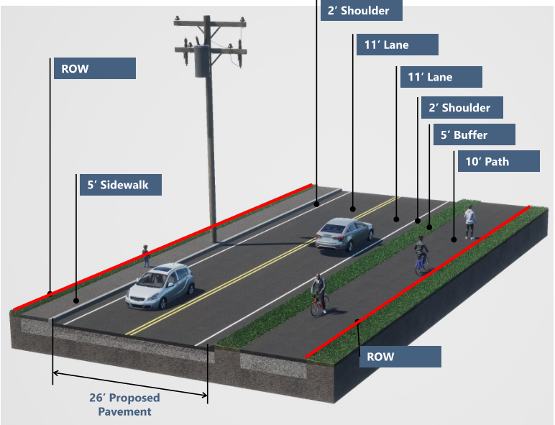
Main Street Option 2

Slide 13
Beach Road
Feasibility Study awarded to VHB
They will identify constraints
Options for further study will result and determine next steps.

Slide 14
Conceptual Timeline for Decision Making and Funding
Old Colony: Engineering Design TM May 2025 ($350K)
    Grant Cycle
Construction Funding TM May 2028 (est. $3 million)
Main Street: Field Survey TM 2025 May 2025 ($100 K)
        Engineering Design Funding Tm May 2026 ( $500K)
Grant Cycle
Construction Funding TM May 2030 (est. $10 million
Beach Road: Feasibility Study: Ongoing
Field Survey 2027
Engineering Design Funding TBD
        Grant Cycle
        Construction Funding TBD

Slide 15
Grant Opportunities to Support Projects
Complete Streets
Mass Trails Grant
Mass Works
TIP
Other

